Slide 1

Networking
Pearson BTEC Higher Nationals Computing and Systems Development

Slide 2
Topics to cover
What is Network
Role of a Network
Peer to Peer and Client Server

Slide 3
What is a Network?
Computers - A group of interconnected (via cable and/or wireless) computers and peripherals that is capable of sharing software and hardware resources between many users.
The Internet is a global network of networks.
Communications - A system that enables users of telephones or data communications lines to exchange information over long distances by connecting with each other through a system of routers, servers, switches, and the like

Slide 4
Role of a Network
cost reduction by sharing hard- and software resources
high reliability by having multiple sources of supply
cost reduction by downsizing to microcomputer-based networks instead of using mainframes
greater flexibility because of possibility to connect devices from various vendors

Slide 5
Role of Network in detail
A computer network is defined as the interconnection of two or more computers. It is done to enable the computers to communicate and share available resources.
APPLICATIONS:
Sharing of resources such as printers
Sharing of expensive software's and database
Communication from one computer to another computer
Exchange of data and information among users via network
Sharing of information over geographically wide areas.

Slide 6
Components of a Computer Network
Two or more computers
Cables as links between the computers
A network interfacing card(NIC) on each computer
Switches
Software called operating system(OS)

Slide 7
Network benefits
The network provided to the users can be divided into two categories:
Sharing
Connectivity

Slide 8
Basic to learn in Network
Peer to Peer Network and Client Server Network

Slide 9
PEER TO PEER
P2P network is created when two or more PCs are connected and share resources without going through a separate server.
A couple of computers connected via a Universal Serial Bus to transfer files
Peers are both suppliers and consumers of resources
Access rights are governed by setting sharing permissions on individual machines.

Slide 10
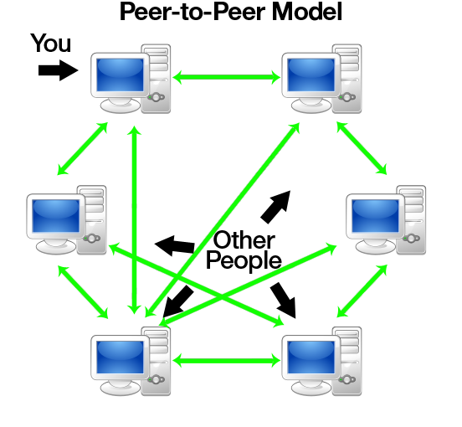
Peer to Peer model

Slide 11
Advantages of Peer to Peer
ADVANTAGES
Use less expensive hardware
User has full accessibility
Ideal for small business and home users
Easy setup and low cost secure

Slide 12
Disadvantages of Peer to Peer
DISADVANTAGES
Not very secure
No central point for storage
Additional load on computer because of resource sharing
Hard to maintain version control
May have duplication of resources
Difficult to uphold security policy

Slide 13
CLIENT SERVER MODEL
Request service, called clients and provide service are called sever
Server is often designed to be a centralized system that serves many clients.
Clients and servers communicate over a computer network on separate hardware
Clients and servers exchange messages in a request response messaging pattern
To prevent abuse and maximize uptime, the server's software limits how a client can use the server's resources

Slide 14
Advantages of Client Server
ADVANTAGES
Centralized security
Faster access
Single password

Slide 15
Disadvantages of Client Server
DISADVANTAGES
Central point of failure
Administrator required
Server software required
Can cause network congestion

Slide 16
Thank You

